Slide 1
An Inquiry into the Cross-States Impacts of Gun-Control Legislations following the 2018 Parkland High School Shooting
Arthur Langlois,
Northeastern University

Slide 2
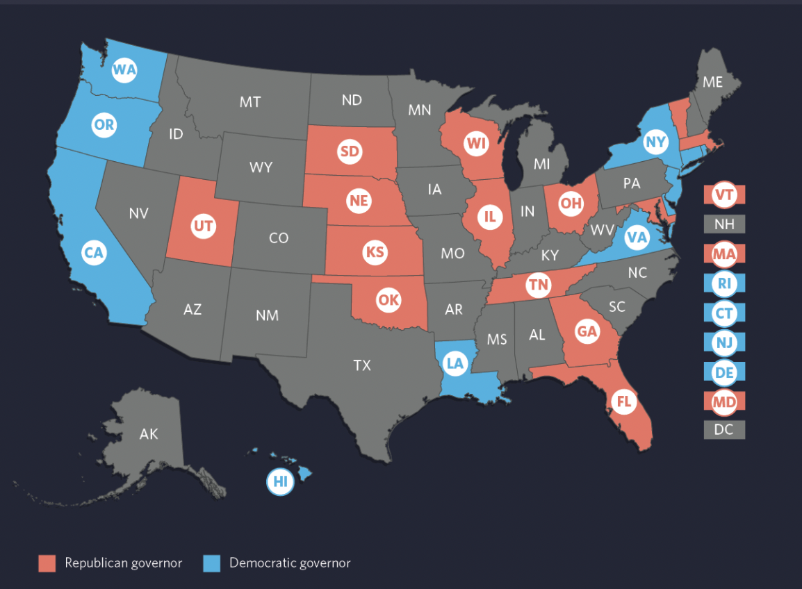
An Inquiry into the Cross-States Impacts of Gun-Control Legislations following the 2018 Parkland High School Shooting
Project Description
Usual thing happened: School shooting in Parkland, Florida, killing 17 people and injuring 15 others
Unusual thing happened: State regulations were put in place, pressured by various movements led by survivors of the massacre
- common motive: control gun access in an attempt to
limit the number of gun violence -and more specifically mass shootings
- half of the states passed at least one legislation
aiming to restrict gun access
- 44 democrats states vs 20 republican states tightening restrictions
(9 republican states lowered their gun laws restrictions)
Source: Pew Research Center

Slide 3
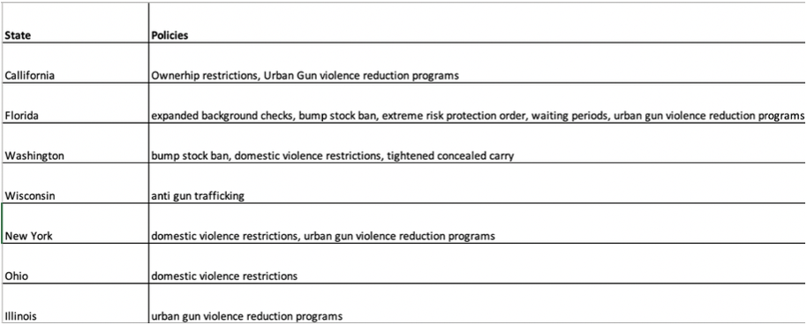
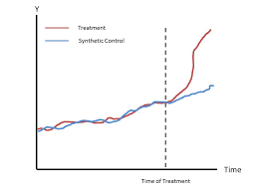
An Inquiry into the Cross-States Impacts of Gun-Control Legislations following the 2018 Parkland High School Shooting
Method & Data
Data: Daily gun incident with number of casualties and injuries between 2014 and 2021 (Gun Violence Archive)&Daily suicide rates at the state level since 1999 (Center for Disease Control)
Goal & Method: We will follow a synthetic control methodology in order to estimate the causal impact of the policies on 1- the total number of gun related incidents 2- the number of gun related homicides 3- the number of gun suicides. More specifically this methodology will be favored over traditional methods used in causal inference due to its interpretability and transparency (Abadie, 2021), and its prevalence in the gun control literature
Notes:
Data:
Sources: Economist Intelligent Unit Data Service, World Bank,
GDP/Capita → Dollars in nominal us dollars
Coca cola and tea bags → control for potential substitution effect.
Age variables: people who drink most of the coffee

Slide 4
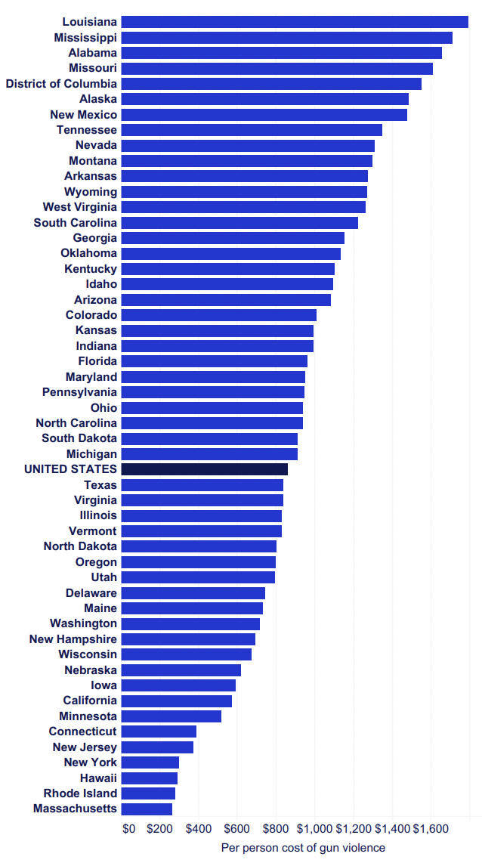
An Inquiry into the Cross-States Impacts of Gun-Control Legislations following the 2018 Parkland High School Shooting
Project Justification
Society bears a large cost from gun violence:
- 45,000 annual deaths linked to gun violence in the country, economic cost is estimated at $280 billion dollars.
- Significant detrimental sociological and psychological, most notably on children, community wellbeing, and often on multiple generations (Cook & Ludwig, 2002, Soni & Tekin, 2020, and Dursun, 2019)
- Gun violence is largely perceived as one of the largest problem in the country, with 72% of the population perceiving it as either a “Very Big Problem” or a “Moderately Big Problem”.
- 80% democrats think gun laws should be stricter vs 20% for republicans (Pew Research Center, 2021, see Figure 3)
Need of rigorous assessment of policies effectiveness aiming at reducing gun violence
Notes:
ECONOMIC LOSS: $3.5 billion of medical costs alone, and an estimated 214.2 billion loss in “intangible loss of victims and survivors due to either a life cut short or a person permanently disabled by gun violence”).

Slide 5
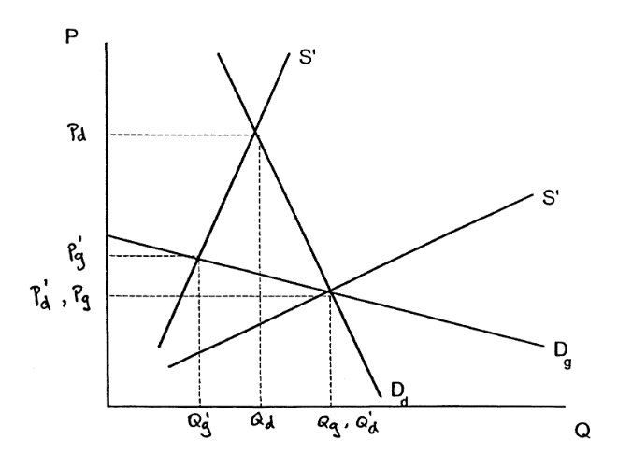
An Inquiry into the Cross-States Impacts of Gun-Control Legislations following the 2018 Parkland High School Shooting
Economics Literature Review
Theoretical Intuition: economic assessment of gun control is grounded on the basic notion of externalities
When guns are available mechanical increase in the number of potential criminals now armed with guns = heightened number of criminal activity, yielding justification for regulations (Cook et al, 2010)
“There is a logical case for regulations designed to preempt criminal use to facilitate law-enforcements efforts, to limit the likelihood of accidental misfires and achieve other public purposes” Cook, 2010
Rendering guns illegal would greatly reduce their demand, due to their elastic nature. (Chaudhri & Geanakoplos, 1998).
Notes:
Let S9 be the supply of drugs (or guns) when they are illegal, and S be the supply of drugs (or guns)
when they are legal. D , D denote the demand for guns and drugs respectively. Then the situation atg d
present is [(P , Q ), (P , Q )] where P , P , Q , denote the price of guns, price of drugs, and theg g d d g d g
quantity of drugs respectively. Now, legalizing drugs, because of the relatively inelastic demand
9schedule only increases quantity demanded to Q , while making guns illegal greatly decreasesd
9demand (to Q ).

Slide 6
An Inquiry into the Cross-States Impacts of Gun-Control Legislations following the 2018 Parkland High School Shooting
Legislation specific literature review
Urban Gun Violence Reduction Programs: Street Outreach, Group Violence, Hospital-Based Violence Intervention Programs (HVIPs), Intervention Programs (GVI) = 50% decline in gun injuries, as well as a 63% decline in shooting victimization (Everytown Research & Policy, 2021).
Domestic Violence Restrictions: ~20% of mass shooters have been accused or convicted of domestic violence (Zeoli & Paruk, 2020). Prohibit gun ownership associated with 10% reduction in intimate partner homicide (Zeoli et al, 2018).
Ownership restrictions: gun ownership rates have a statistically significant and positive effect on the homicide rates
(Gius, 2009) and most gun control restrictions in large cities have no significant effects on violence rates (Kleck, & Patterson, 1993)
Expanded background checks: 22% of current gun owners did not go through background checks (Miller et al., 2017). More extensive background checks prior gun purchase are associated with both a decrease in firearm homicide and suicidal deaths (Sen & Panjamapirom, 2012).
Red Flag Laws: ERPOs are associated with a diminished number of gun related deaths, with most notable results regarding suicides , results support through comparative research in Indiana and Connecticut by Kivisto in 2018 (Kivisto et al., 2018)
Notes:
Data:
Sources: Economist Intelligent Unit Data Service, World Bank,
GDP/Capita → Dollars in nominal us dollars
Coca cola and tea bags → control for potential substitution effect.
Age variables: people who drink most of the coffee

Slide 7
An Inquiry into the Cross-States Impacts of Gun-Control Legislations following the 2018 Parkland High School Shooting
Conclusion
The combination of high societal costs of gun violence along with the importance place it has taken in political debate calls for the need of rigorous assessment of policies effectiveness aiming at reducing gun violence.
The rising importance of gun violence in public debate has motivated the members of the scientific community to undertake empirical research to understand the legislation-specific impacts on gun related deaths.
Careful analysis of the existing literature evaluating the legislation-specific impacts on gun violence both motivate and help construct robust hypotheses for our study. The results of this research can provide guidance to policymakers and the general public at large regarding the effectiveness of these crucial policies.

